Slide 1
ENGINEERINGCourse Presention
Student: Fengdi Huang
Student ID: 231AHG003

Slide 2
Contents of this Presentation
What is Engineering | Engineering is the application of science and math to create solutions for real-world problems
What is Engineering to Me | It is a foreign concept to me before this course.
Examples of Engineering in Real Life | Mechanical, electrical, computer, civial, social and more.
Data Engineering | Designing, building, and maintaining systems to collect, process, and manage large volumes of data for analysis and decision-making purposes
What’s My Interest | Data Science for Social and Political Science
Engineering and Career Path | Problem Solving, Innovation and Creativity, Interdisciplinary Collaboration

Slide 3
Table of contents
1.
2.
3.
4.
5.
6.
What is Engineering
Examples of Engineering
What is Engineering to Me
Data Engineering
My Interest and Engineering
Career Path and Engineering

Slide 4
1.
What is Engineering

Slide 5

What is Engineering
Engineering is the application of scientific principles and mathematical methods to design, build, and improve structures, machines, systems, and processes to solve practical problems and meet human needs.
Key Words: scientific principles; mathematical methods; design; build; improve; solve problems; meet human needs

Slide 6
Catigories of Engineering
Virtual Engineering Disciplines
Physical Engineering Disciplines
Civil Engineering
Mechanical Engineering
Electrical Engineering
Aerospace Engineering
Materials Engineering
Computer Engineering
Software Engineering
Data Engineering
Telecommunications Engineering
Systems Engineering

Slide 7
Process of Engineering
Identify the Problem
Research and Analysis
Conceptual Design
Detailed Design and Development
Prototype and Testing
Evaluation and Iteration
Production and Implementation
Deployment and Maintenance

Slide 8
2.
What is Engineering to me

Slide 9
What is Engineering to me
Problem solving | Application of science and technology
innovation | collaboration

Slide 10
3.
Engineering in Real-Life

Slide 11
Dive Watch Design Evolution
1. Early Design (17th to 19th century)
4. Seiko’s solution
Wax
Covering case
Screw down crown
Seiko introduced "monocoque" case construction, where the case back and bezel were integrated into a single unit for enhanced water resistance.
2. Oyster case (1926)
5. ISO 6425 standard (1996)
The first modern solution for water resistant watch case.
The watch was worn by Mercedes Gleitze when she swam across English Channel
The ISO 6425 standard defines specific requirements and testing criteria for water resistance, shock resistance, anti-magnetic properties, and legibility in diver watches.
3. Submariner case (1953)
6. Modern Innovations
The Rolex Submariner featured a rotating bezel with minute markers for tracking dive time, along with luminescent hands and markers for improved legibility underwater.
Computer simulations and pressure chamber tests, ensure that modern diver watches meet stringent performance standards for underwater use.

Slide 12

How can water get into the case

Slide 13
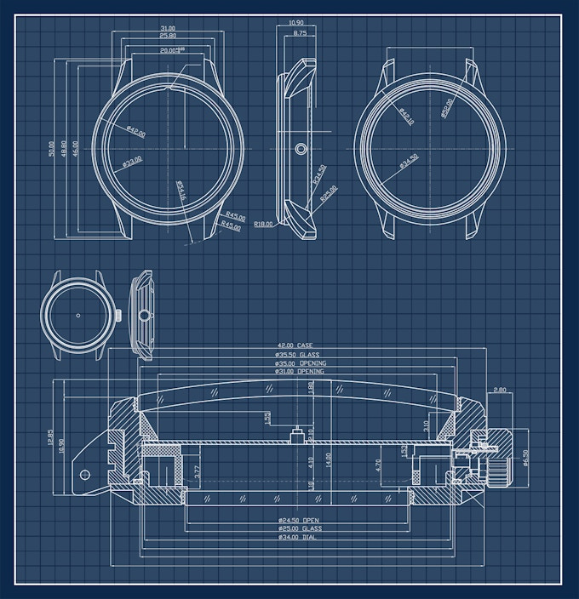
Where can water get into a watch
Case Back: Water can seep into the watch through gaps between the case back and the case.
Crown: If the crown is not properly screwed down or sealed, water can enter the watch through the crown tube and compromise the movement.
Crystal: The crystal, which covers the dial and protects the watch face, can allow water to enter if it is not properly sealed to the case

Slide 14
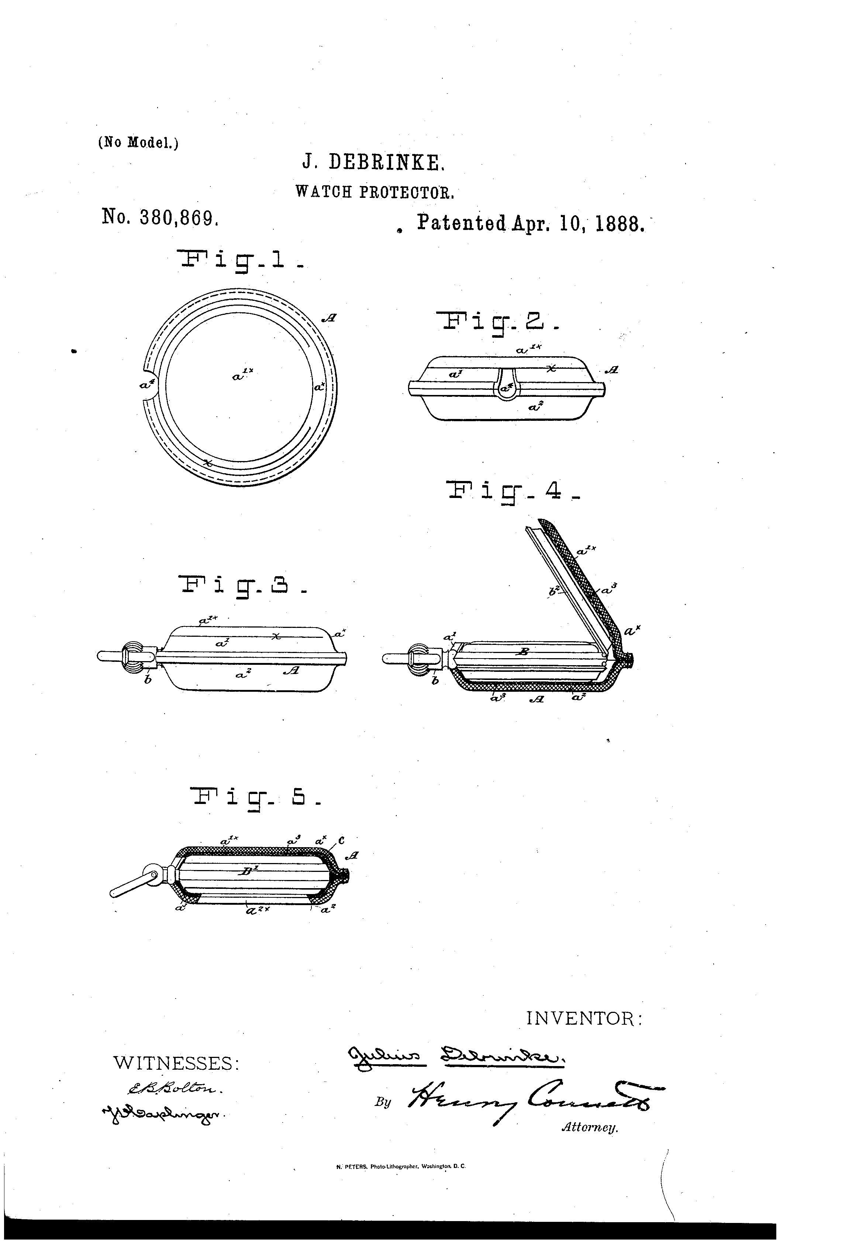
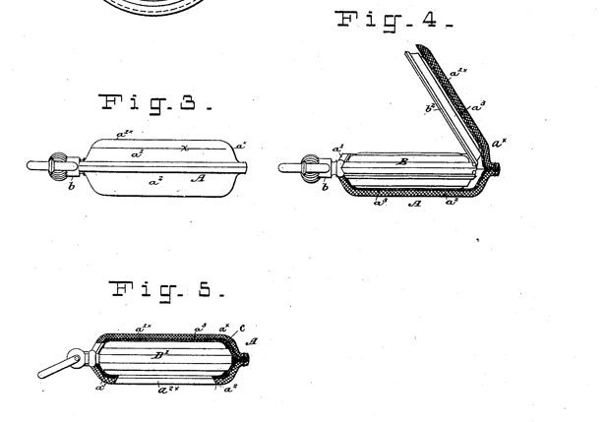
Early Design (17th to 19th century)

Slide 15
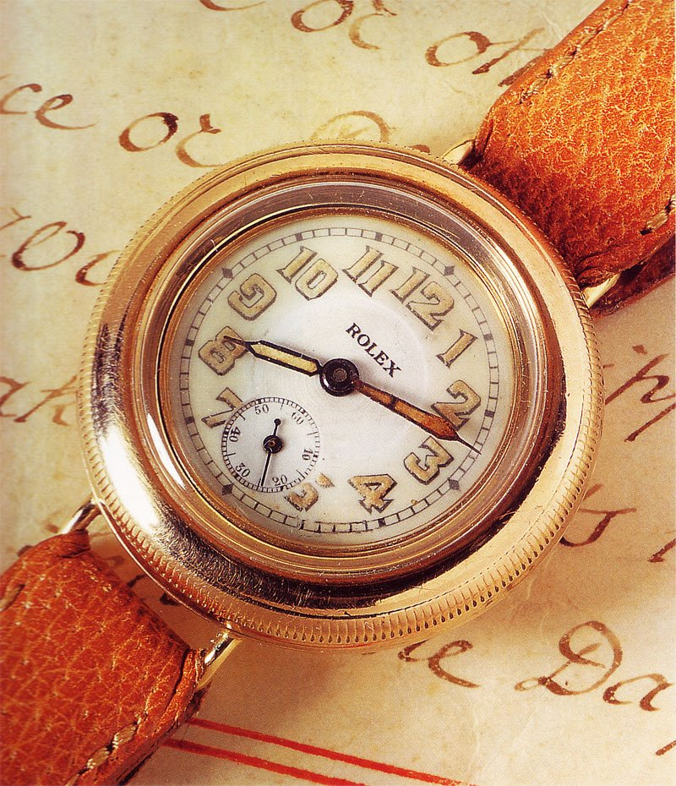
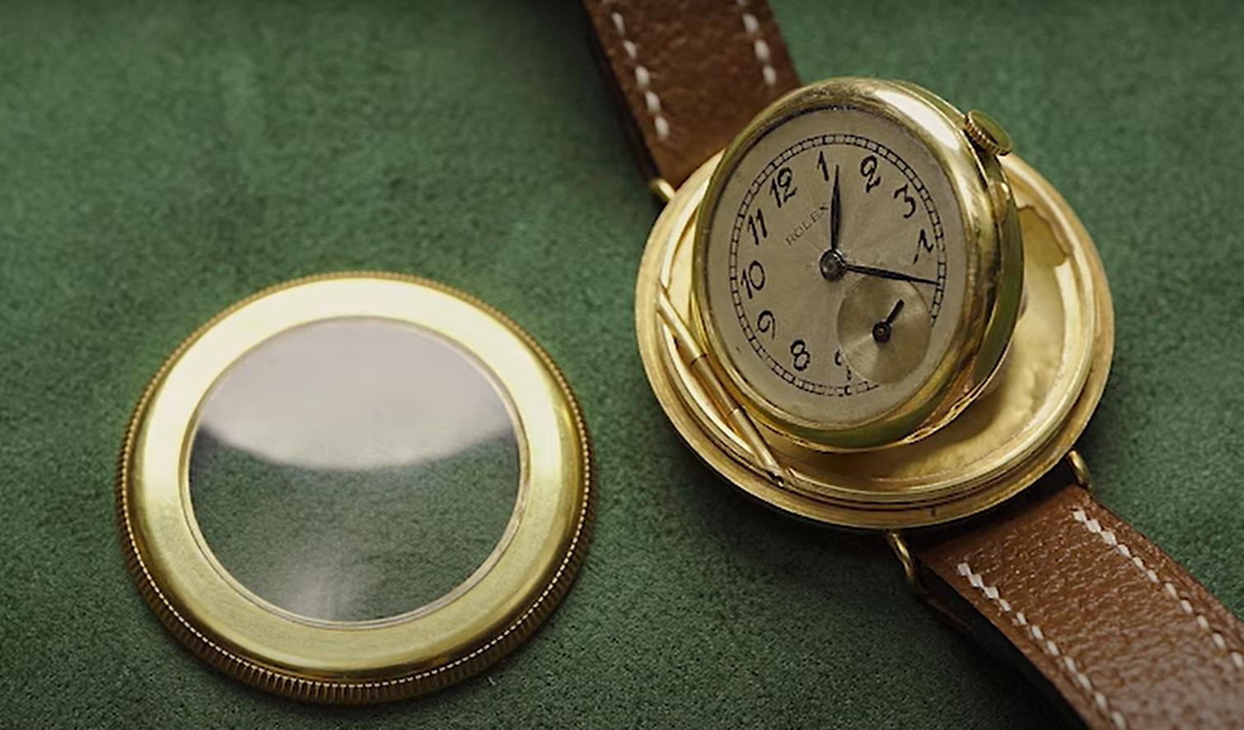
Early Design (17th to 19th century)

Slide 16
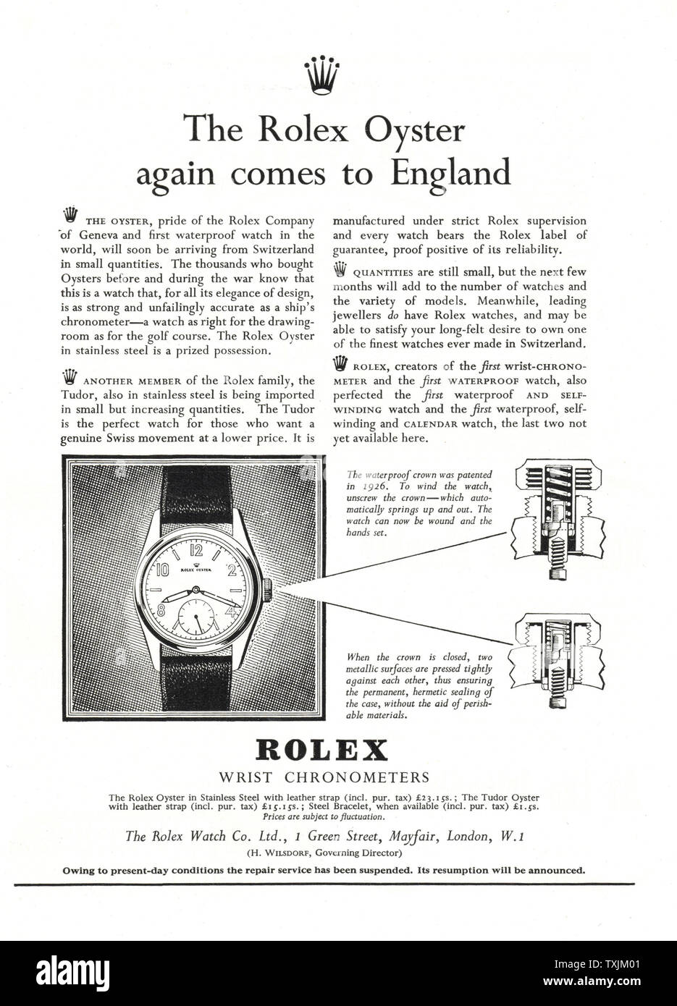
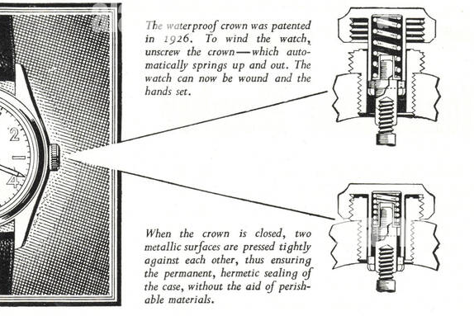
Oyster Case by Rolex (1926)

Slide 17
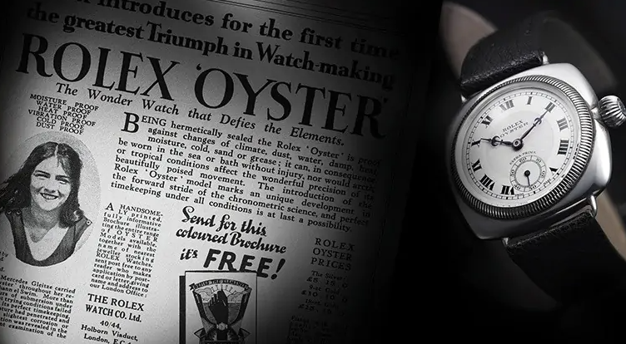
Oyster Case by Rolex (1926)

Slide 18
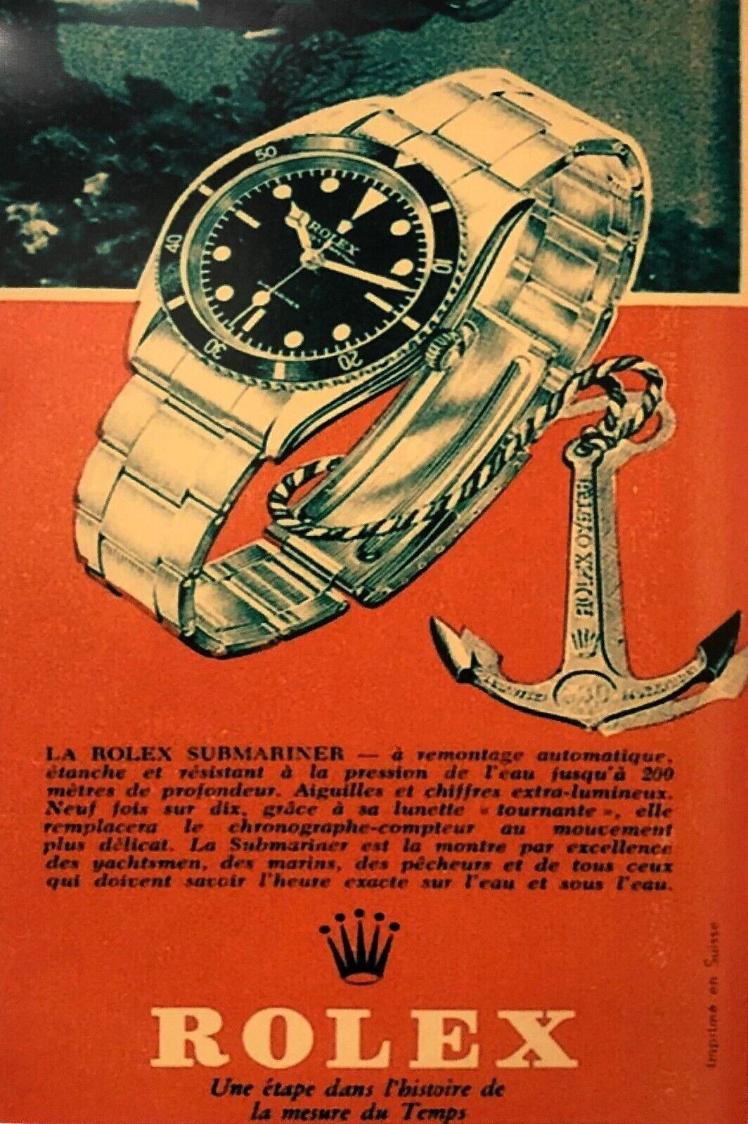
Submariner Case by Rolex (1953)
Building on the success of the Oyster case, Rolex introduced the Submariner in 1953, specifically designed for underwater use.
The Rolex Submariner featured a rotating bezel with minute markers for tracking dive time, along with luminescent hands and markers for improved legibility underwater.
The Submariner set the standard for diver watches and became an iconic timepiece worn by professional divers and enthusiasts alike.

Slide 19
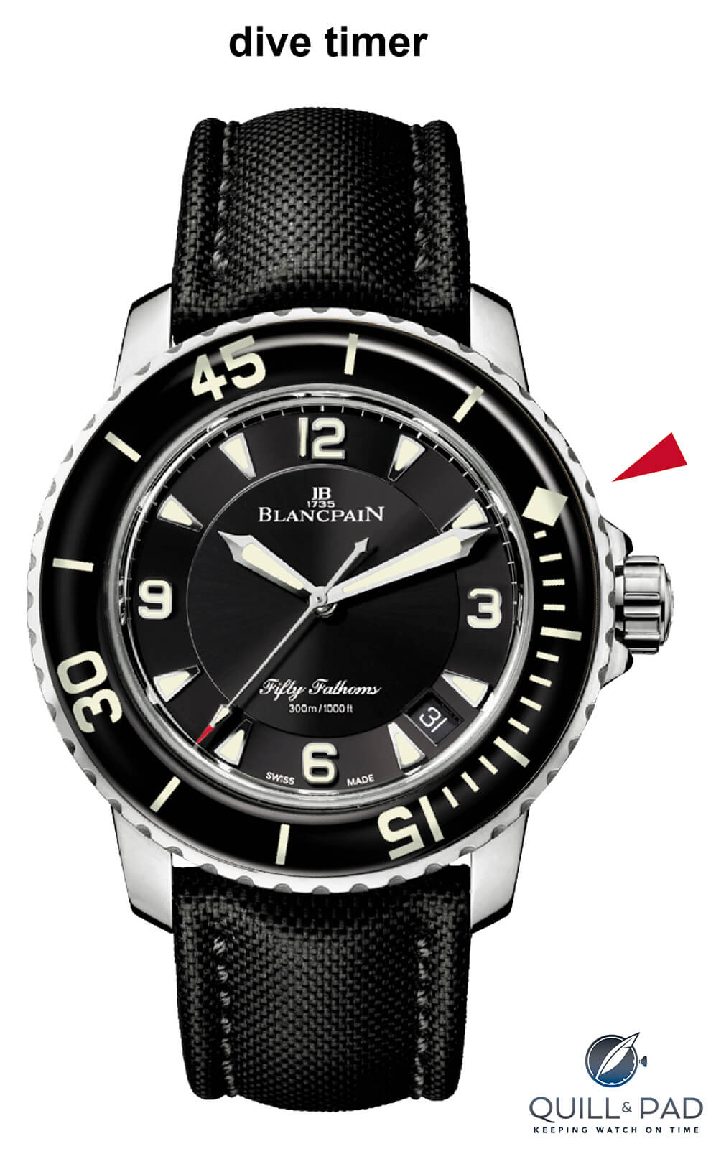

Slide 20

Lume for divers
Introduction of Radium-Based Luminous Paint In the early 20th century
Shift to Tritium-Based Luminous Paint: In the 1960s and 1970s
Development of Super-LumiNova and Other Non-Radioactive Materials after the 1980s

Slide 21


Slide 22


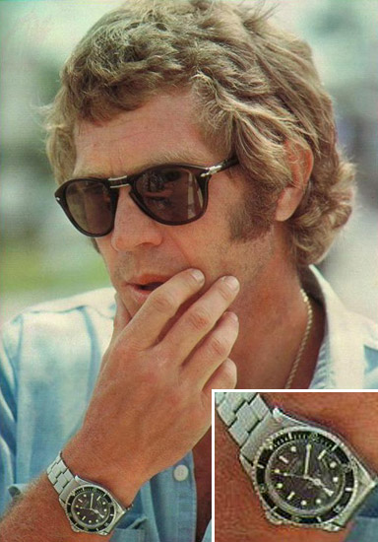

Slide 23
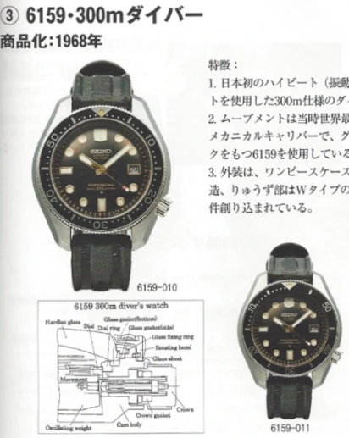
Seiko’s “One PIECE” case (1960s)
In the 1960s, Japanese watchmaker Seiko made significant contributions to water-resistant watch design with its line of dive watches.
Seiko introduced innovations such as the "monocoque" case construction, where the case back and bezel were integrated into a single unit for enhanced water resistance.
Seiko's dive watches, including the Seiko 62MAS and subsequent models, offered reliable performance at depths of up to 150 meters and became popular choices among divers worldwide.

Slide 24
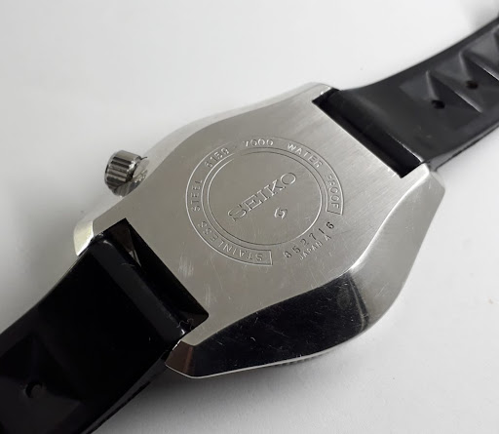
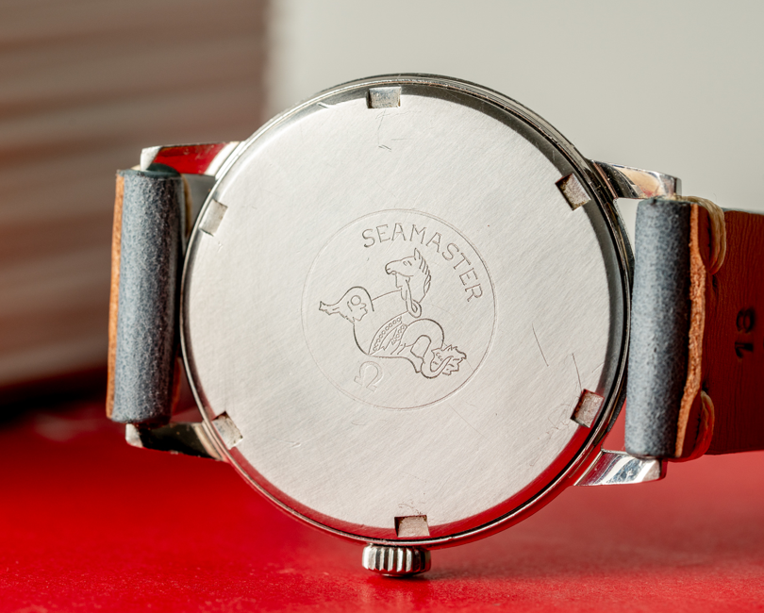
Seiko’s “One PIECE” case (1960s)

Slide 25
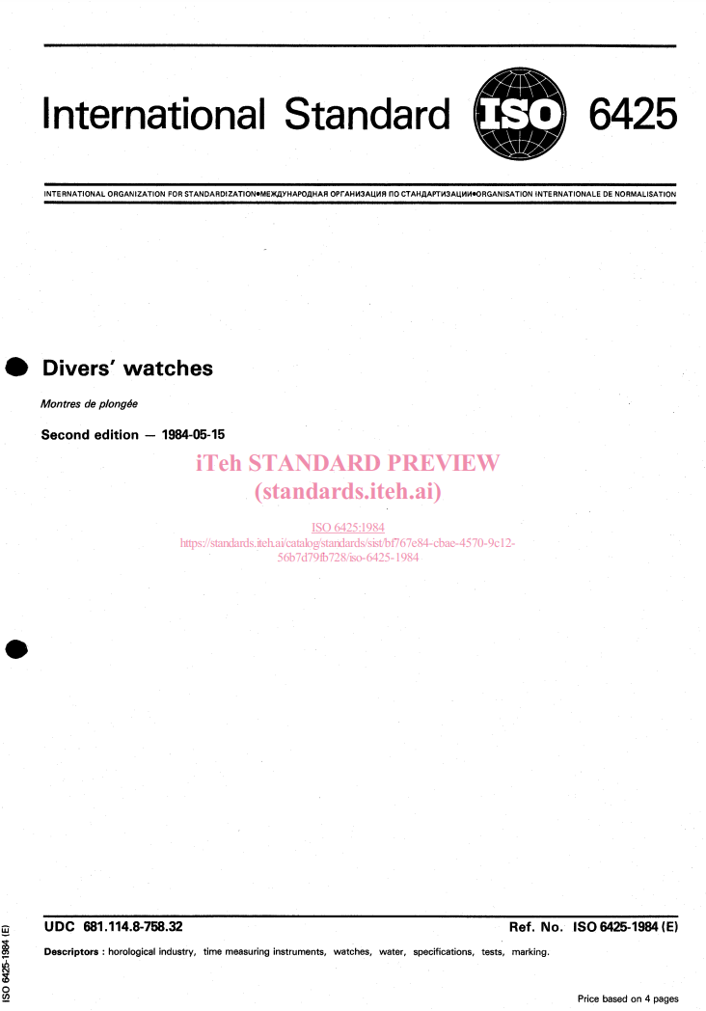
Iso 6425 standard (1996)
In 1996, the International Organization for Standardization (ISO) established the ISO 6425 standard for diver's watches.
The ISO 6425 standard defines specific requirements and testing criteria for water resistance, shock resistance, anti-magnetic properties, and legibility in diver watches.
Watches that meet the ISO 6425 standard are certified as suitable for diving and are marked with the "Diver's" or "Diver's 200m" designation.

Slide 26

Modern Innovations (21st Century)
In recent years, advancements in materials, manufacturing techniques, and engineering have led to further improvements in water-resistant watch design.
High-performance materials like ceramic, titanium, and synthetic seals are now commonly used to enhance water resistance and durability.
Advanced testing methods, including computer simulations and pressure chamber tests, ensure that modern diver watches meet stringent performance standards for underwater use.

Slide 27
4.
Data Engineering

Slide 28
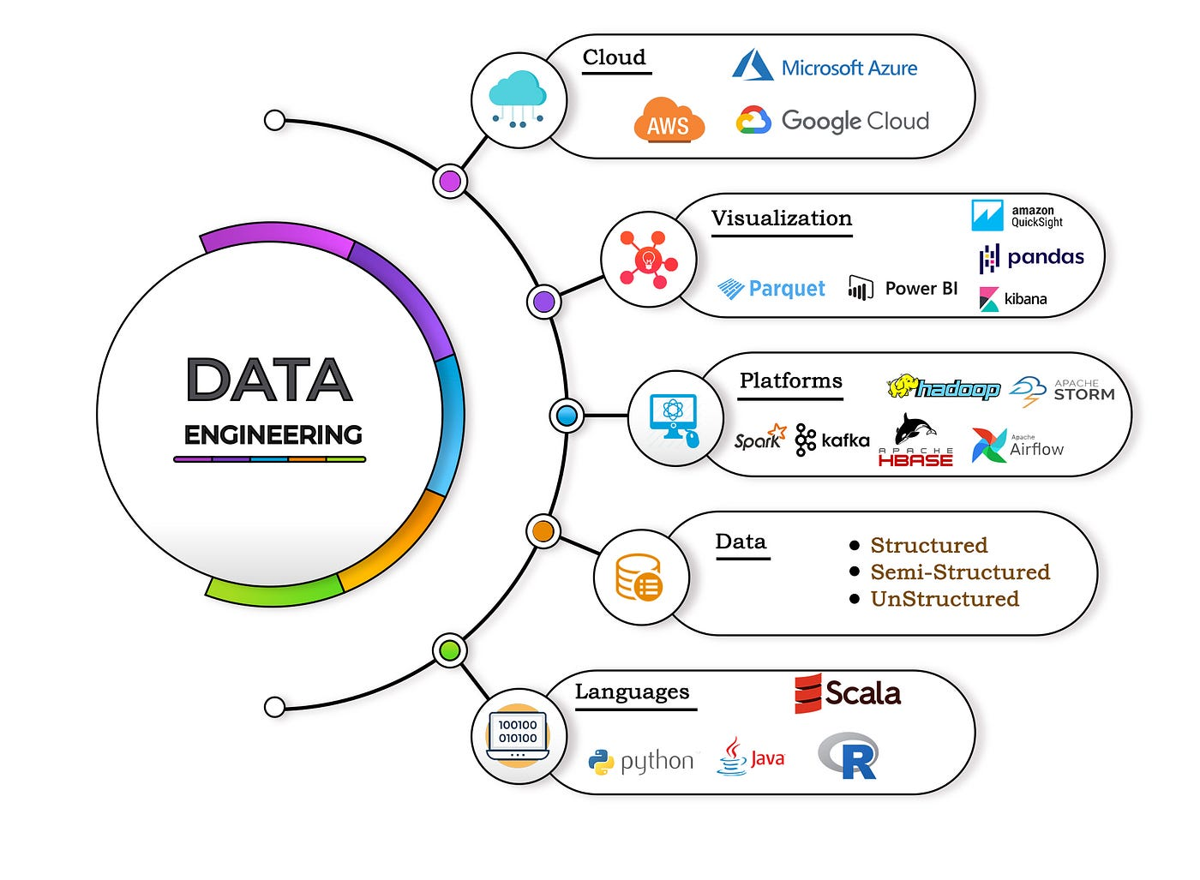
Data Engineering
Data engineering is a field within the broader realm of data science and engineering that focuses on designing, building, and maintaining systems for managing and processing large volumes of data.
Data engineers play a crucial role in the development and operation of data infrastructure, pipelines, and architectures that enable organizations to collect, store, transform, and analyze data efficiently and effectively.

Slide 29
Public opinion spectrum analysis
Research and planning
Data Collection and Cleaning
Pre-Processing Data
Thematic Clustering
Manually Label Data for ML Training
Model Selection and Training
Viladation and Interpretation
Visualization

Slide 30

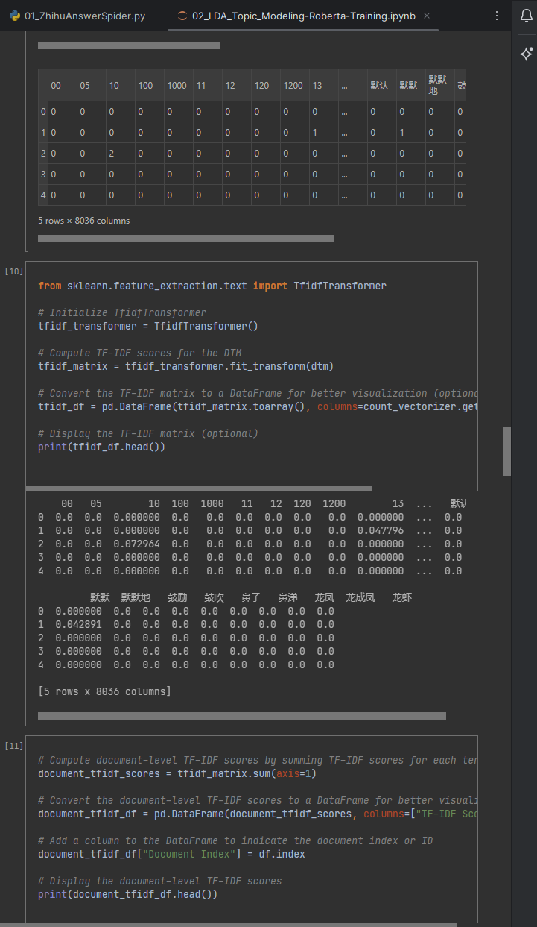
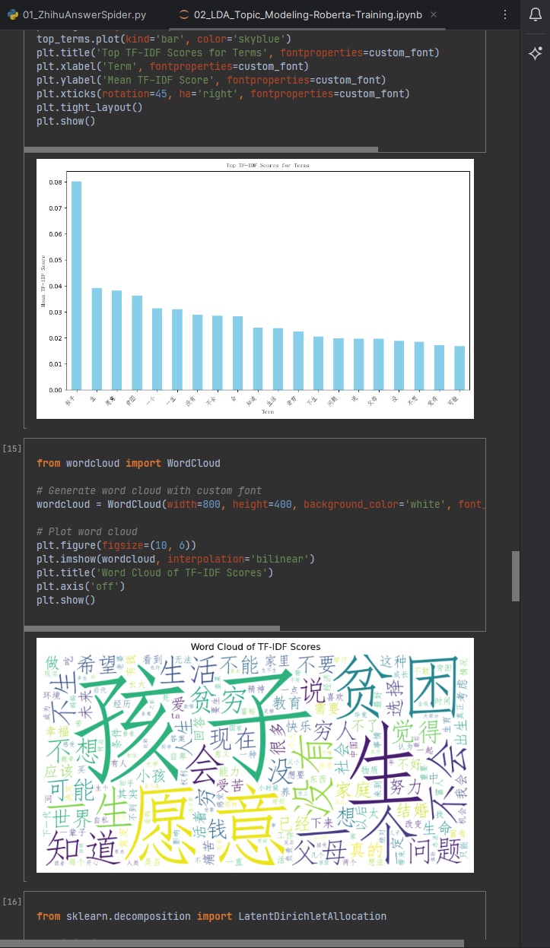
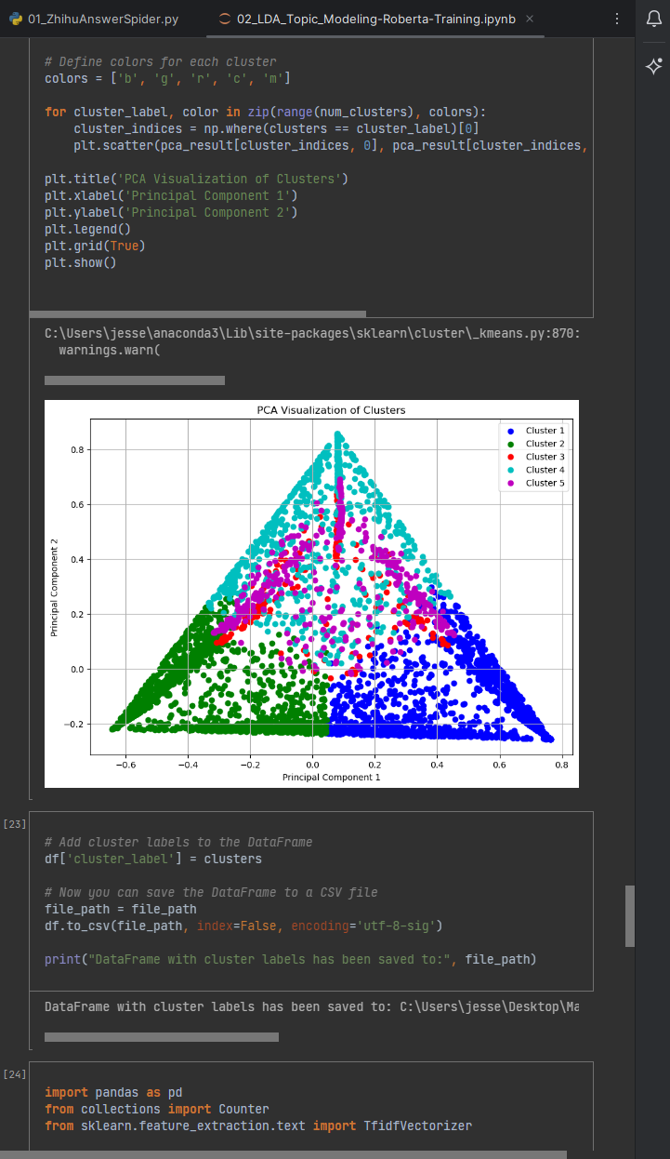
Code, code, code…… and more code

Slide 31
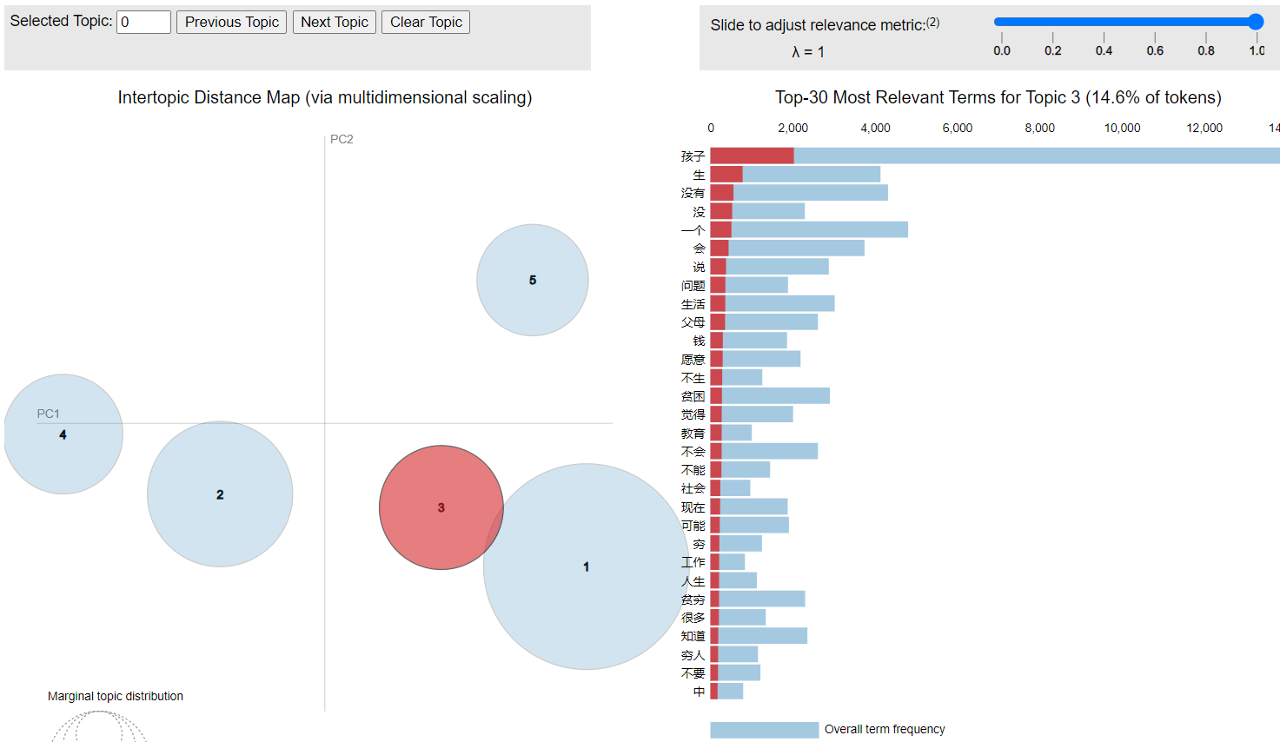
Visualization can help better understand

Slide 32
5.
What is my interst

Slide 33

What is my Interest
To use data to:
Analyze
Understand
Make predictions

Slide 34
6.
Engineering and career path

Slide 35
How engineering mindset can help
Problem-solving skills
Analytical thinking
Attention to detail
Technical literacy

Slide 36
The end thank you

